Slide 1
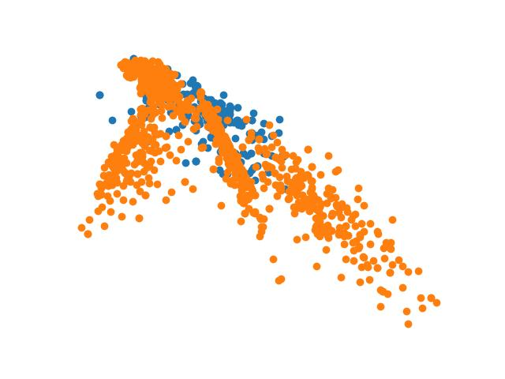
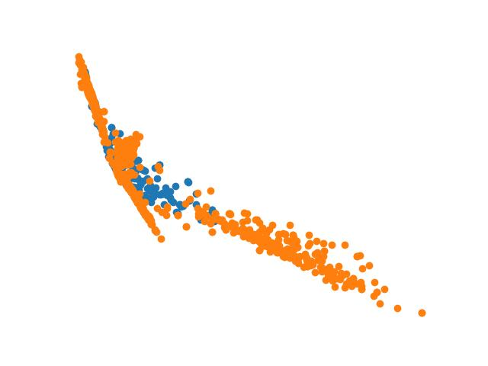
Contrast-GMMs
As Open-World Learning

Slide 2
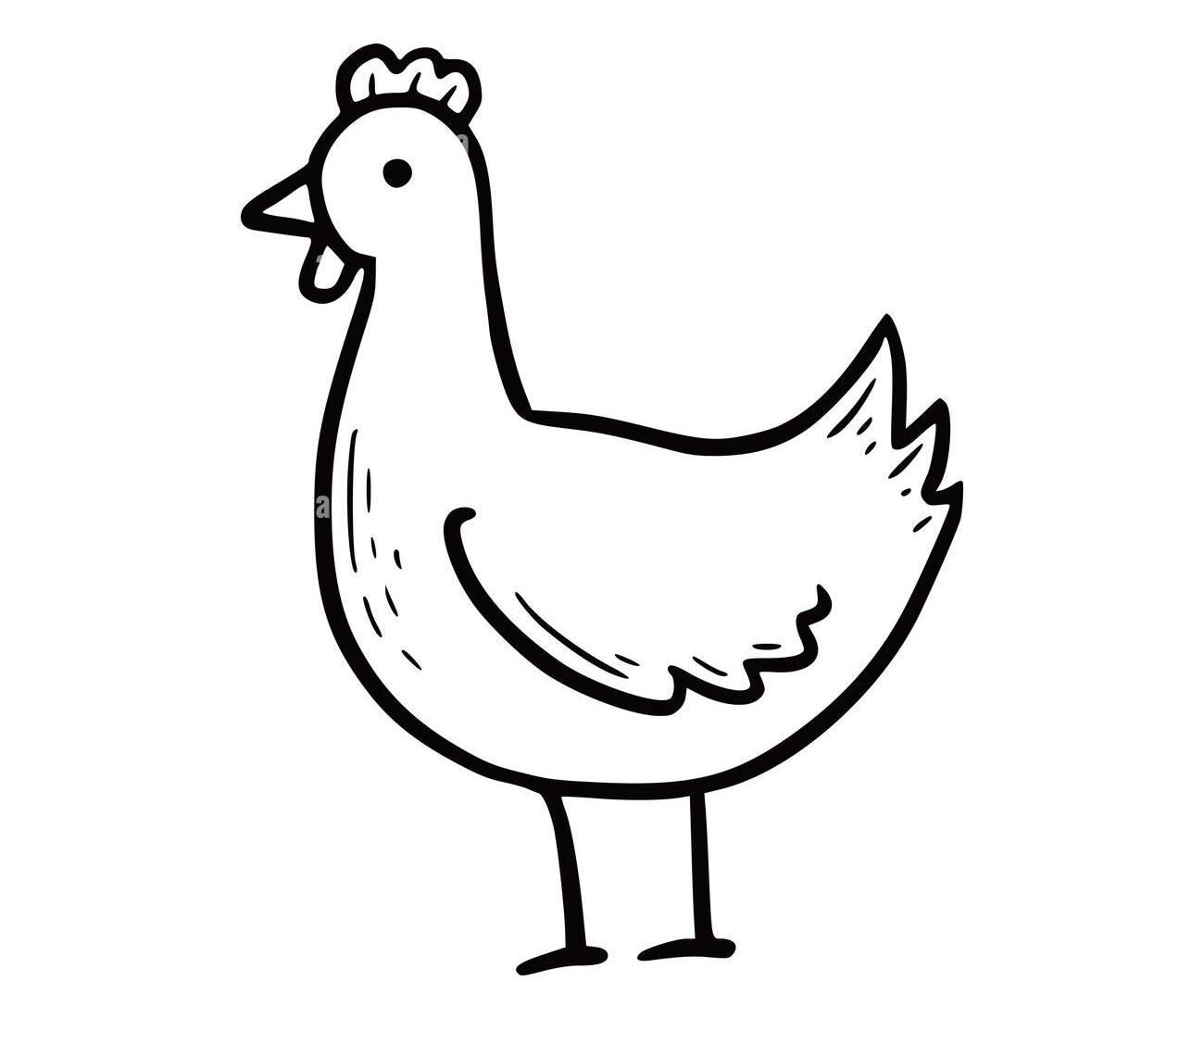
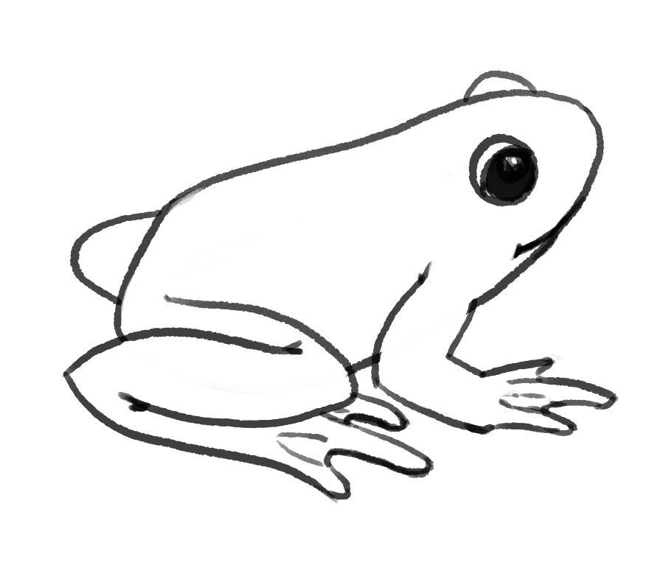
Open-World Learning: an overview
In the wake of Deep-Learning’s success across many benchmarks (recognition, segmentation, prediction), researchers aim to make such models robust. These models are closed-set; that is, they are trained on some fixed n classes at training time and are expected to only encounter those n classes at test time.
Black-Box
Model
Black-Box
Model
“Chicken”
Training-Time
Test-Time
Notes:
Kobi Notes: - Discuss concept of closed set (only dealing with classes seen during training time)

Slide 3
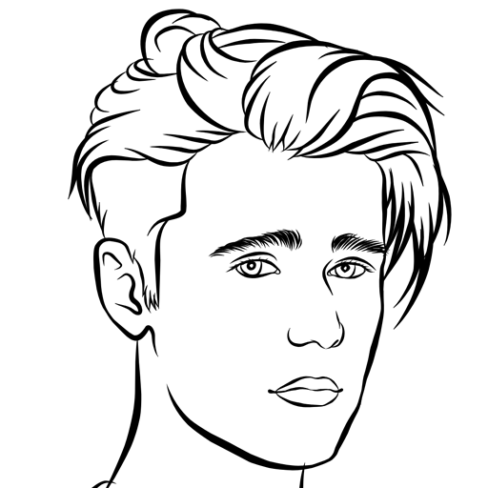
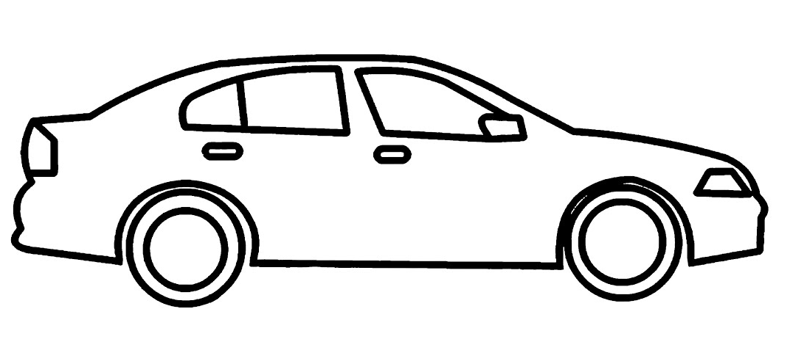
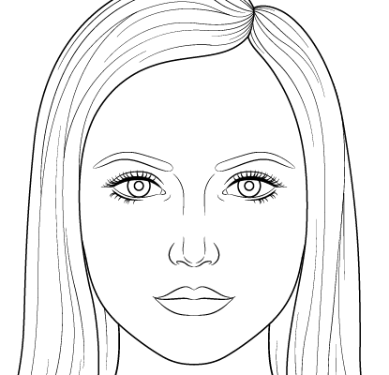
Open-World Learning: an overview
The real world is not so clean. Rather, we adapt to new classes frequently, and closed-set models suffer under domain shift: change in either (i) the ground-truth relationship between X and y, or (ii) change in the covariates (X) between train-time and test-time.
Black-Box
Model
training
wear/tear on the car tires changes the problem dynamics over time
Black-Box
Model
deployment
(i) Change in ground-truth relationship between X and y
(ii) Change in covariates (X) between train-time and deployment
Notes:
Kobi
Real world applications are dirty, they need to be resilient to changes and handle them reasonably.
Fundamental relation is changing (Outside world is changing)
Seen data is changing (Properties of data changing)

Slide 4

Open-World Learning: an overview
And most notably, we often encounter classes during deployment unseen at training-time.
Black-Box
Model
Black-Box
Model
“Chicken”
Training-Time
Deployment
Notes:
Kobi:
An example of this, is seeing an entirely new class during deployment (like a walrus). In this case, we would not want our model to predict a preexisting class, but instead would want it to predict that this is not like what it has seen prior.

Slide 5
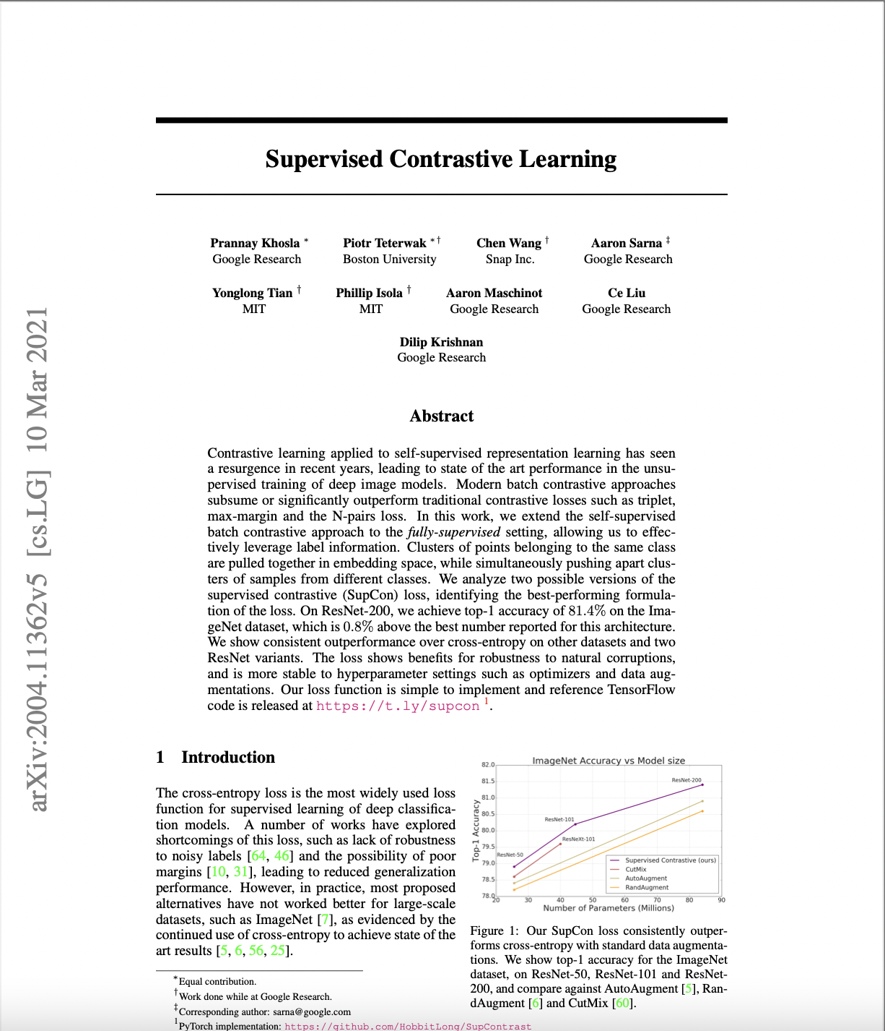
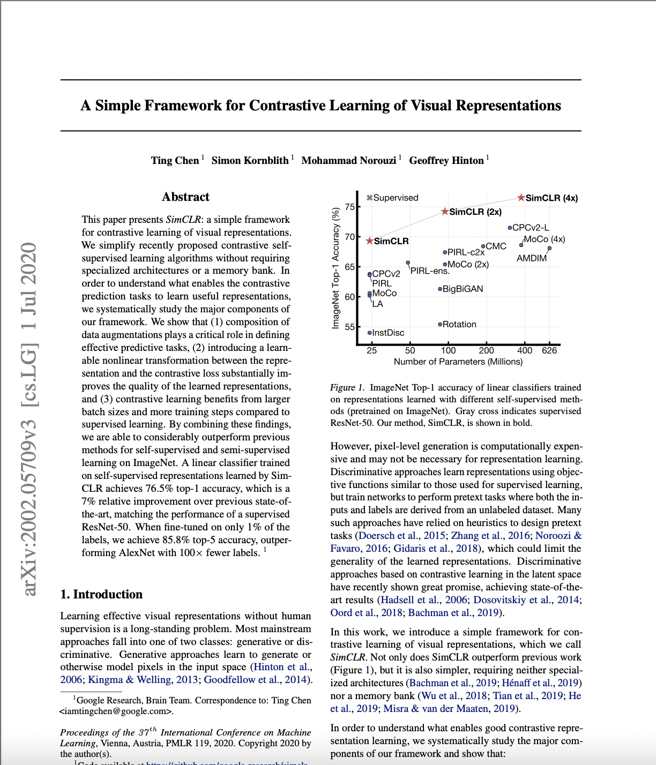
Related Works
Literature: We draw primarily from the Contrastive-Learning, Open-World Learning, and 3D-Classification literature for our work
Motivation: Create sparse embeddings, learn empirical boundaries around them
Contrastive-Learning

Slide 6
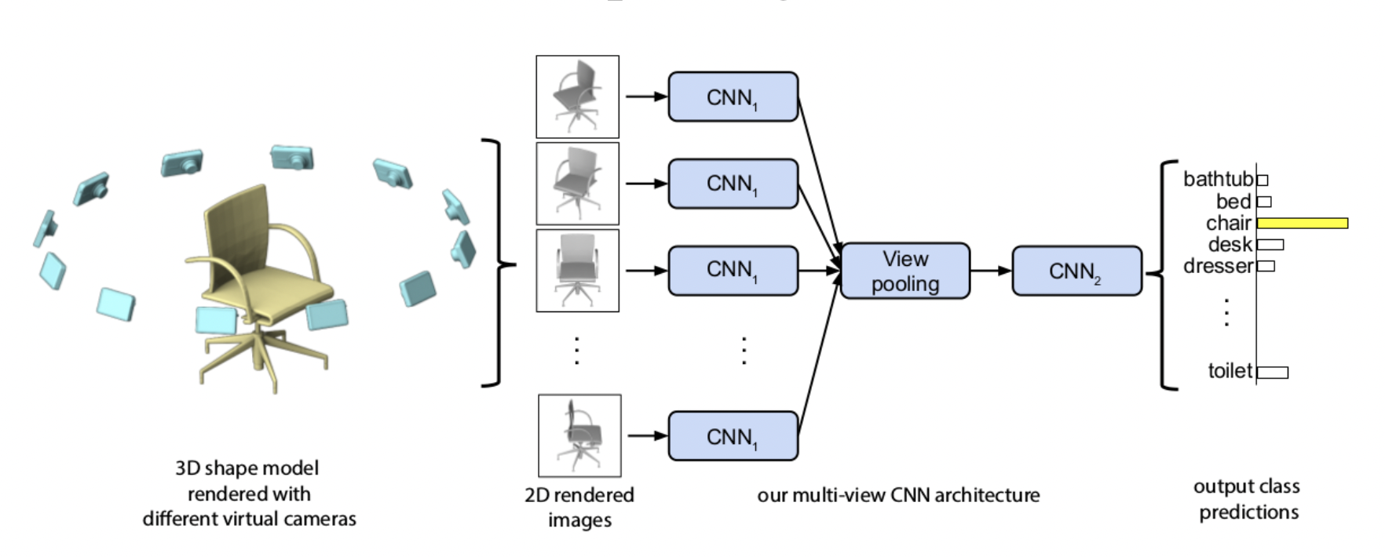
Related Works
We integrate the existing Open-World Learning literature with Multi-View CNNs, since almost all of this literature is in 2D!

Slide 7
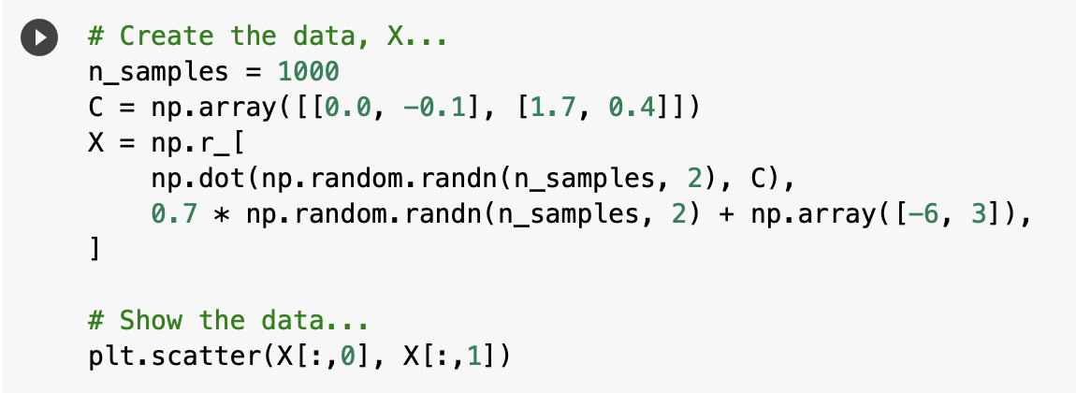
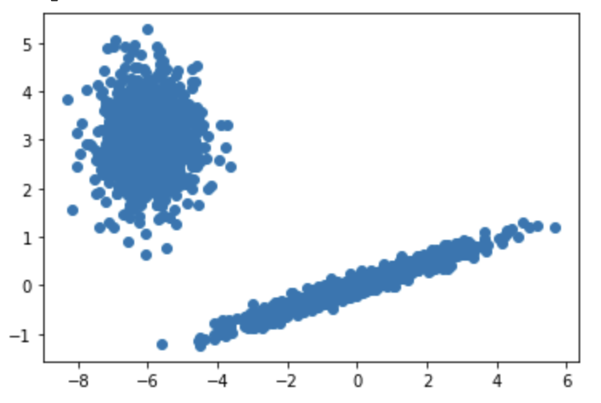
Open-World Learning: Gaussian Mixtures
Here we create two clusters of data points in R² (two-dimensions)
We’ll specify how many clusters we think there are; in this case, two.
Notes:
First, we present a quick motivation for Gaussian mixtures as Open-World Learning. Consider these two (deeply unrealistic) distributions, both with wildly different covariance relationships between their respective points. The Gaussian mixture will be told that there are–at least initially–two distinct classes. These classes correspond to our distributions, and in an Open-World Learning scenario are “known” classes.

Slide 8
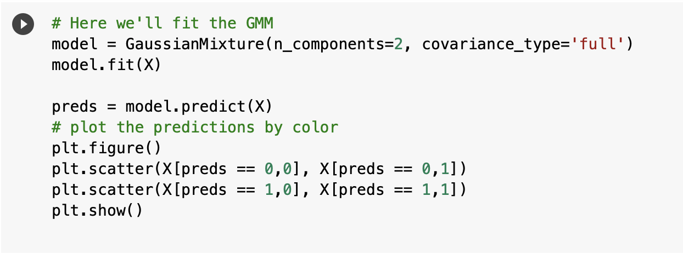
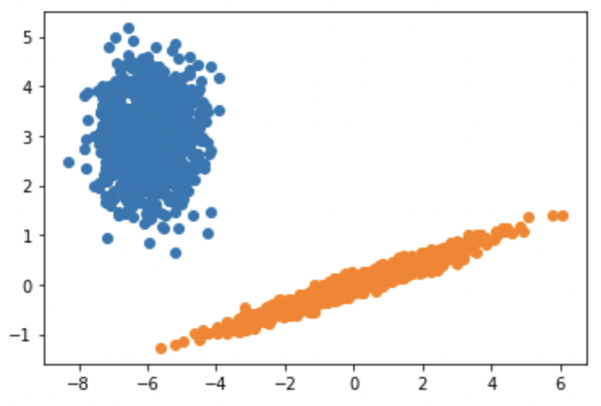
Open-World Learning: Gaussian Mixtures
We fit the model using Expectation-Maximization, which selects the model which empirically maximizes the log-likelihood
Notes:
Our Gaussian mixture model fits the data using Expectation-Maximization, a variational learning algorithm which maximizes the likelihood. Here, we plot the classifications and find them agreeable; however, so far this is all standard unsupervised learning.

Slide 9
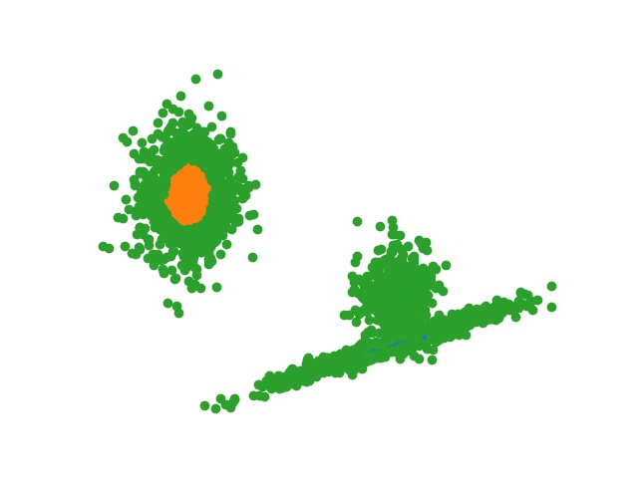
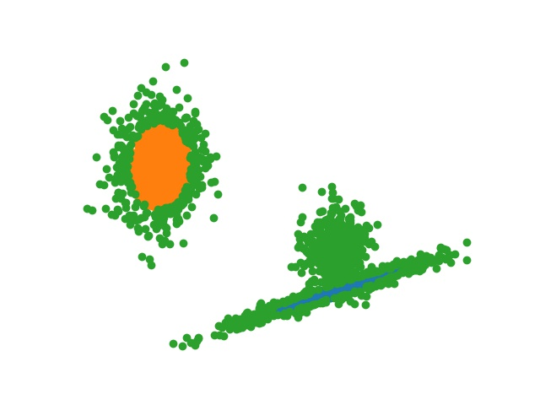
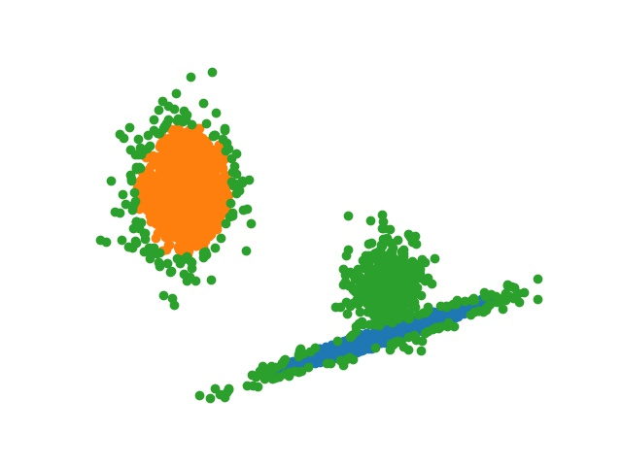
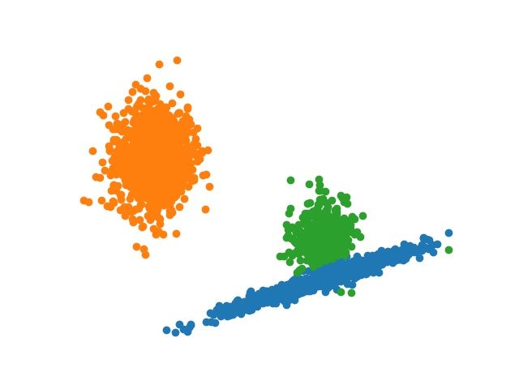
Open-World Learning: Gaussian Mixtures
We can also restrict classifications by the distance between the cluster and a given point (this is not Euclidean – it’s a standard dev for Gaussian called mahalanobis distance)
Figure: Green points represent rejected points (those too far from the two clusters to classify as either)
This is a form of novelty detection, where confidence in classification can be determined empirically
Notes:
Gaussians are interesting from an Open-World perspective because we can leverage a multidimensional standard deviation called “The mahalanobis distance” to set a conservative boundary around our points. Essentially, we’re thresholding the distance between each point and its predicted cluster mean. Those that exceed some cutoff can be labeled as “novel” – belonging to a class we haven’t seen before, or that we feel uncomfortable in classifying with confidence.

Slide 10
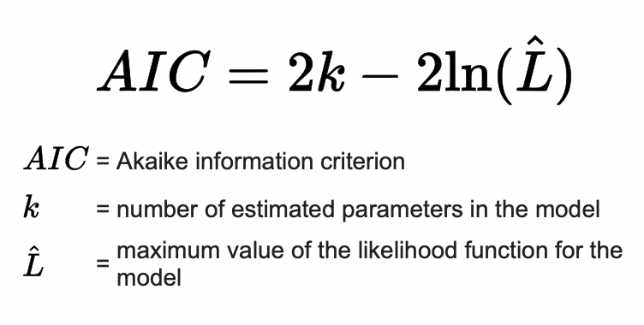
Open-World Learning: Gaussian Mixtures
Since the clusters are determined empirically, we can also perform model selection at any point using AIC information criterion
The AIC criterion weights the Log-Likelihood against the number of clusters (this acts as a regularizer against overfitting)
Provided enough points of the novel data class, we can refit the model to identify a new cluster.
Notes:
Additionally, we can apply standard model selection criteria like AIC or BIC to choose a model which better fits the data; that is, if a model with 3 classes better fits the data than one with 2, we know to select the former (barring some regularization parameter to prevent overfitting). We’ll show an example of what this may look like on the next slide.

Slide 11
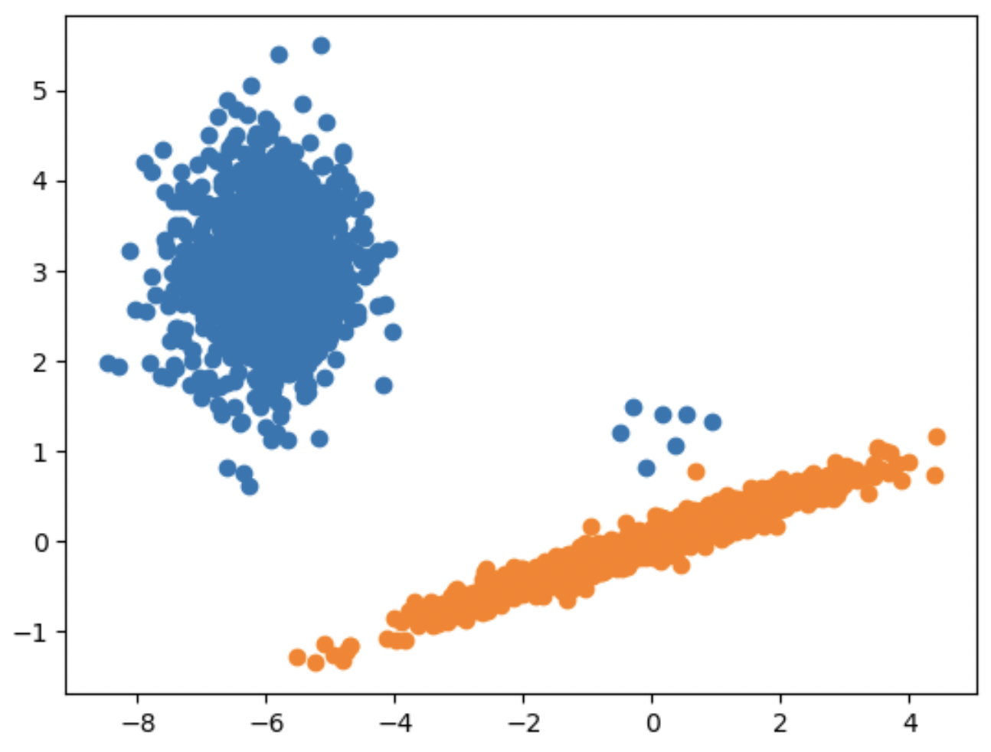
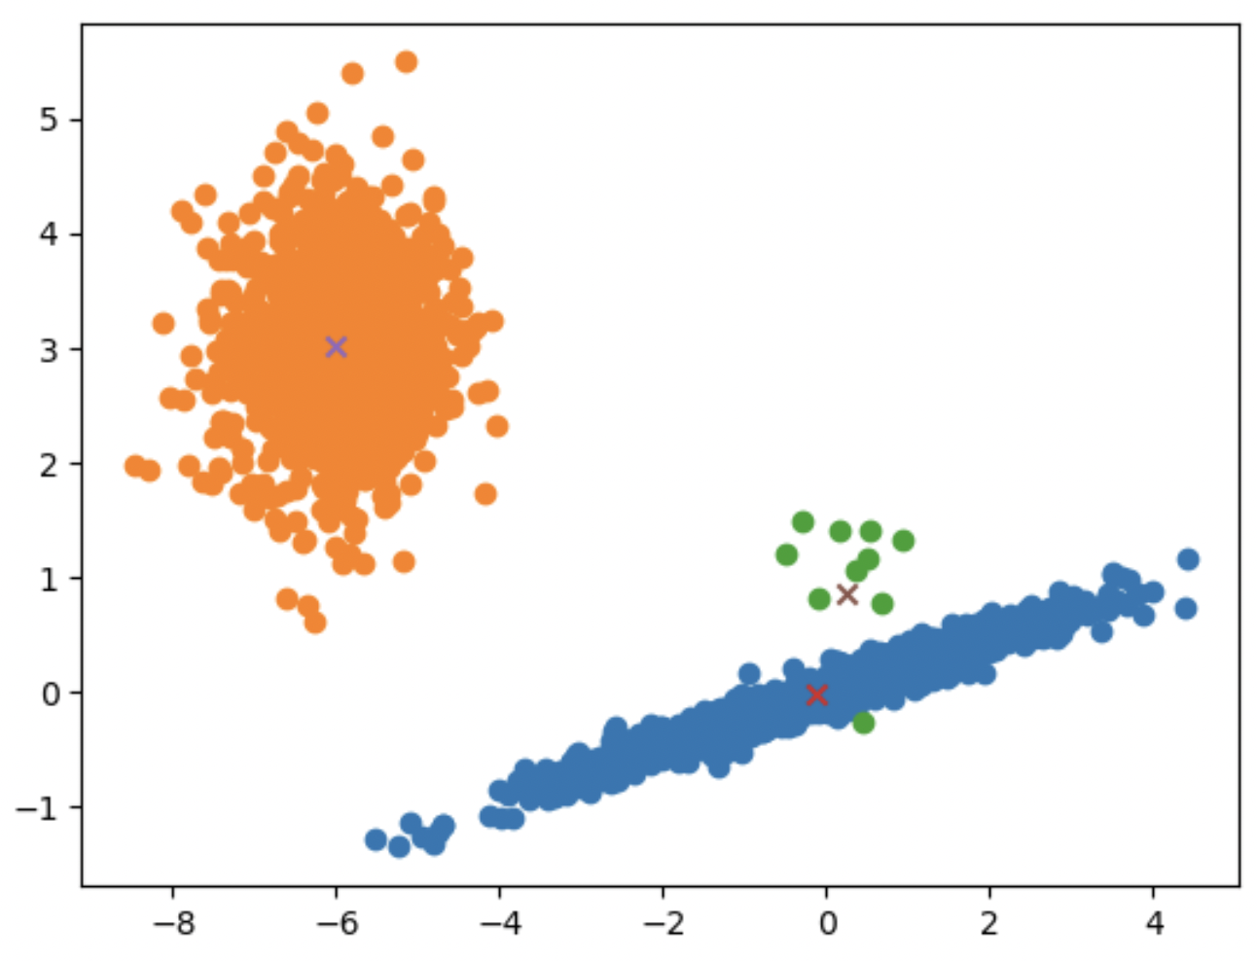
Open-World Learning: Gaussian Mixtures
Since the clusters are determined empirically, we can also perform model selection at any point using AIC information criterion
If the AIC is better for three-cluster model instead of two-cluster mode,
retrain
Notes:
Here we present two classifications: one with two classes and the other with three. By selecting the model with higher AIC criteria, we can identify this third green Gaussian pretty easily. One problem with Gaussian fitting, however, is that they obviously have minimal learning power to identify the high-level relationships standard in deep learning, so our work attempts to bridge this divide.

Slide 12
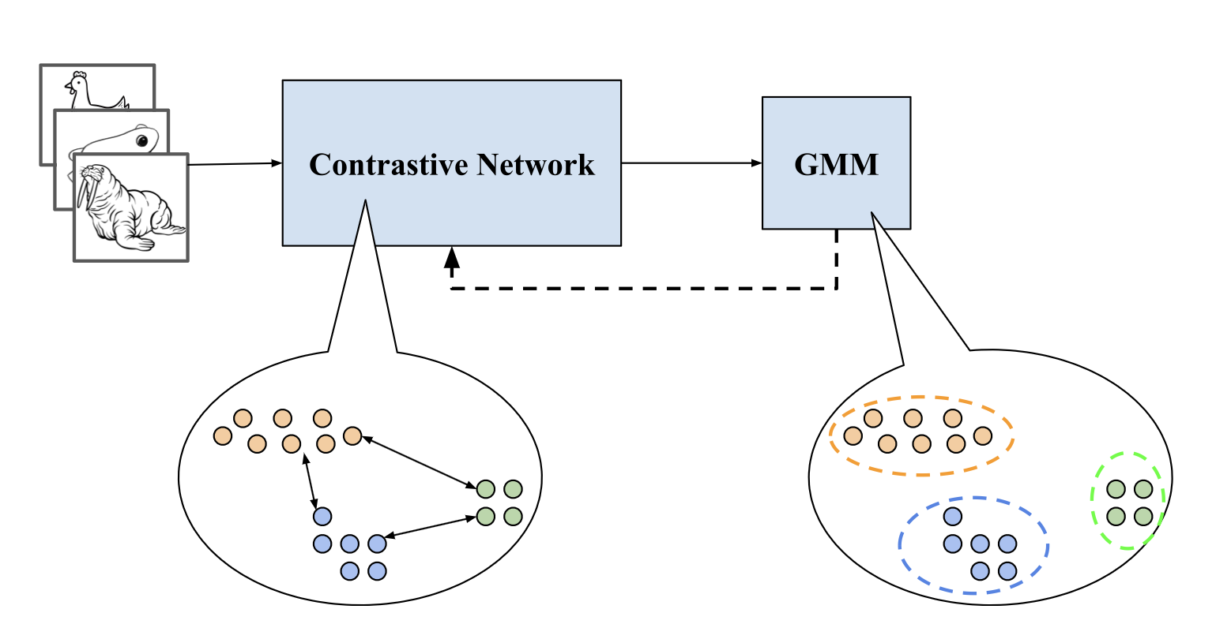
Open-World Learning: Contrastive-GMMs
Our method incorporates a Gaussian penalty term into a traditional Contrastive-Learning framework
Contrastive Block: provide separated embedding space
GMM Block: provide feedback on how easily we can fit that space
Figure: Our model architecture decomposed into a Contrastive block and GMM block
Notes:
Our architecture is composed of (a) a contrastive block which transforms the 3D shape data into separated embeddings and (b) a Gaussian Mixture Model which provides feedback in terms of how easily it can fit those embeddings. Thus the loss term is composed of a supervised contrastive loss and the gaussian log-liklihood.

Slide 13
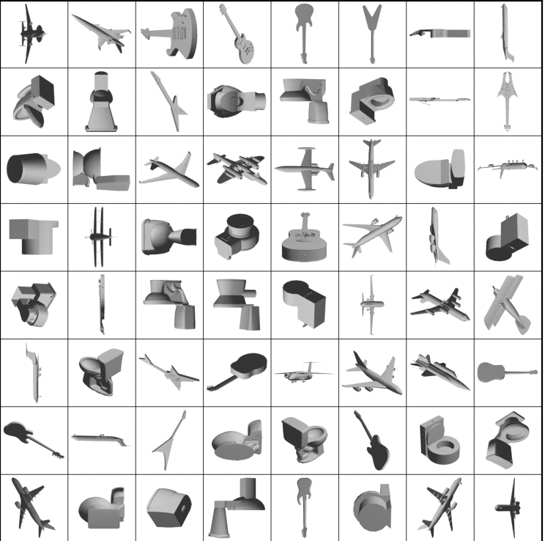
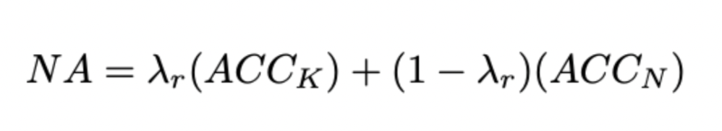
Evaluations
Dataset: We evaluate our model performance on the ModelNet40 dataset
Why: Many different types of object classes
Since the importance of novel instances is unclear, we evaluate with a scaled (𝝺) accuracy:
Notes:
(Preston)
For our evaluation, we use the ModelNet40 dataset on our model and baselines. We use this dataset specifically because we want to run the models on many different types of object classes to get an idea of how well they perform in novelty classification on a wide spectrum.
Since the importance of novel instances is unclear, we evaluate with a scaled accuracy “lambda”, which ranges from 0 to 1; the smaller the lambda, the higher we weight the accuracy of purely the novel instances. For example, a lambda of 1 simply reports the accuracy of classification on known classes (i.e, a traditional closed-set classifier)

Slide 14
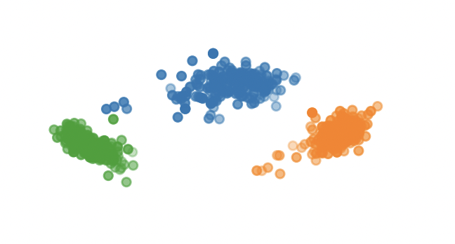
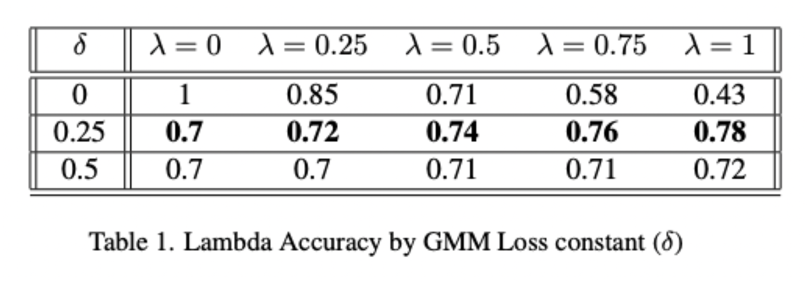
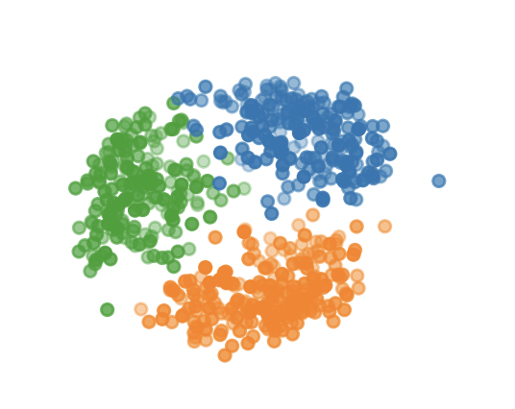
Experiments: Ablation
We scale (𝛅 above) our Gaussian penalty and note that the ideal mixture prefers the contrastive penalty by a fraction of ~1/2
Figure: learned embeddings without Gaussian penalty (top) and with Gaussian penalty (bottom)
Notes:
We performed an ablation experiment to determine the impact of the Gaussian penalty on our accuracy and learned embeddings, providing both quantitative and qualitative results. Above you can see our learned embeddings are much sharper and potentially more difficult to learn in the above image (which is solely contrastive loss) than the gaussian embeddings below it. Obviously de-emphasizing the contrastive loss term will harm the sparsity of our embeddings, and quantitatively this appears supported by our experiments. The sweet spot (that is, with the highest accuracy on both novel and known instances) is 𝛅 = 0.25 which essentially means we’re preferring the contrastive penalty by a factor of ½.

Slide 15
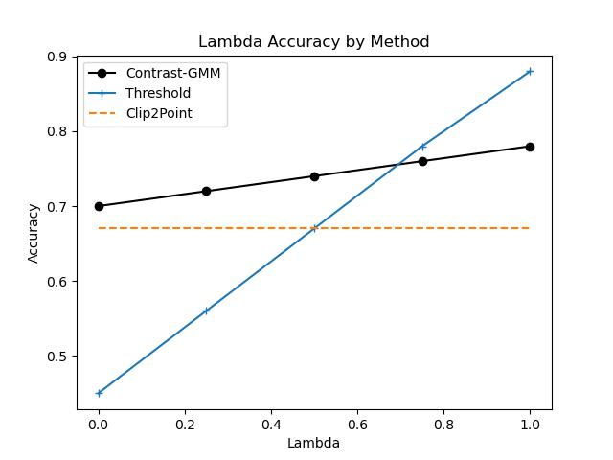
Experiments: Novelty Detection
Threshold
If prediction confidence is below a threshold, predict it’s novel
Most efficient with threshold of 0.95
Clip2Point
Leverages LLM to do zero-shot-learning on point data
Figure: Accuracy by lambda-value (𝝺). Smaller lambdas corresponds to higher weighting of the novel instances – i.e, a lambda of zero evaluates accuracy only on the novel set.
Notes:
We compare our model against a simple Open-Set method (confidence-thresholding) and a recent LLM-based Zero-shot approach in the form of Clip2Point. While the latter’s ModelNet benchmarks are public, the first method is non-trivial. We train a MV-CNN equivalently-deep to our own for the task of classification and mark predictions with probability below some threshold as “novel”.
Kobi
Threshold: see if confidence value for all classes is below a given threshold
Clip2Point. Leverages a pointcloud as context to an LLM to predict the class of a model. If the LLM thinks the next word in the sentence is not a word describing a given class, it predicts the pointcloud as Novel
Finally we have the graph comparing them. On the X axis is a Lambda value which weights the accuracy of the novel instances vs the known class instances. A lambda of 0 in this case corresponds to the accuracy of predicting a dataset full of novel instances as novel.

Slide 16
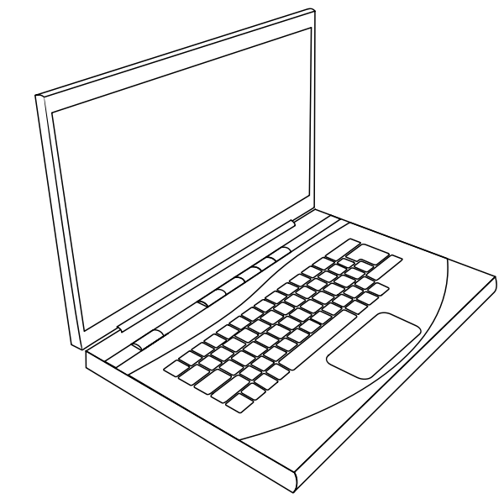
Limitations
Baseline models not common
Not many projects looking at novelty classification
Augmenting pre-existing projects was required
Lack of resources (GPUs)
Hard to emulate other studies that had GPUs
Our model was difficult to run (had to use colab T40)
Limited testing with data due to time constraint
Only got to train and run on a small set of the open world data
Cannot train on more data due to lack of time
Notes:
(Preston) For limitations on our project, we find that creating baseline models to compare to our model was a very difficult task to complete.
They were difficult because there are not many projects that perform novelty classification.
We had to Modify some of these models to take in 3D inputs and serve our purpose, which took a lot of time to implement.
We also struggled with lack of resources, specifically GPUs. It was hard to emulate other studies that required GPUs to run it.
Our model was difficult to run, so we had to use Colab T40.
Finally, we were limited in testing the model on only a small set of the open world data due to time constraints.
We only had limited amount of time to train and test our model as a project, and trying to train and run on a larger set would take up time.

Slide 17

Conclusion
Takeaway
We present a smaller alternative to comparable zero-shot models that need not be retrained from scratch to learn progressively from new instances
Future Work
Train on much bigger set of open world data
More empirical evaluation classifying between novel classes
Here, we focus almost exclusively on novelty detection
More empirical evaluation of the model over time;
When is it beneficial to retrain the model from scratch on new data vs. retraining the Gaussian Mixture Model
Notes:
(Preston)
In conclusion, we are able to present a smaller alternative to comparison zero-shot models that do not need to be retrained from scratch in order to learn progressively from new instances.
For future work, we would like to train our model on a much bigger set of open world data and see how our model performs.
We would also like to use more empirical evaluation classifying between novel classes; in our project, we almost exclusively focused on novelty detection.
Finally, we would like to explore more into empirical evaluation of our model over the span of time. For example; we would like to explore the question of “When is it beneficial to retrain the model from scratch on new data, versus retain the Gaussian Mixture Model”.

